Slide 1

ПРОДАЖИ ПРОДУКЦИИ ФОСАГРО НА БИРЖЕВЫХ ТОРГАХ
ВЛАДИМИР ХАРИТОНОВ
30.09.2020 г.
Notes:
Титульный слайд 3

Slide 2
Реализация продукции на биржевых торгах СПбМТСБ
1 квартал 2019 г.
Реализуемая продукция:
МАР (Аммофос) 12:52
2020 г.
Реализуемая продукция:
МАР (Аммофос) 12:52
NPK(S) (DAFK) 10:26:26(2)
NPK(S) 15:15:15(10)
NP(S) 16:20(12)
NP(S) 20:20(14)
4 квартал 2019 г.
Реализуемая продукция:
МАР (Аммофос) 12:52
NPK(S) (DAFK) 10:26:26(2)
NPK(S) 15:15:15(10)
Notes:
Africa: fastest growing continent
More than half of global population growth between now and 2050 is expected to occur in Africa. Africa has the highest rate of population growth among major areas. The population of sub-Saharan Africa is projected to double by 2050.
Economic Growth
The continent's economy grew by roughly 3.4 percent in 2017, creating one of the longest stretches of uninterrupted positive economic expansion in Africa's history. As a result, a growing number of Africans have joined the middle class each year.
According to the forecasts for the period 2018-2024, consumption of the fertilizers in Africa will increase 4,8% every year.
The key factors are: growth of the population, reduced availability of arable land.
Along with the development of the infrastructure, transfer of knowledge, support of agriculture and increased funding, we expect growth in the use of fertilizers.

Slide 3
Реализация продукции на биржевых торгах СПбМТСБ
Январь – декабрь 2019 г.
Январь – сентябрь 2020 г.
Notes:
Africa: fastest growing continent
More than half of global population growth between now and 2050 is expected to occur in Africa. Africa has the highest rate of population growth among major areas. The population of sub-Saharan Africa is projected to double by 2050.
Economic Growth
The continent's economy grew by roughly 3.4 percent in 2017, creating one of the longest stretches of uninterrupted positive economic expansion in Africa's history. As a result, a growing number of Africans have joined the middle class each year.
According to the forecasts for the period 2018-2024, consumption of the fertilizers in Africa will increase 4,8% every year.
The key factors are: growth of the population, reduced availability of arable land.
Along with the development of the infrastructure, transfer of knowledge, support of agriculture and increased funding, we expect growth in the use of fertilizers.

Slide 4
Объемы продаж 2019-2020 гг., план 2021 г.
Показатели продаж: 2019 г., 2020 г. (факт 9 мес.), 2021 г. (предварительный план), тонн
Notes:
Africa: fastest growing continent
More than half of global population growth between now and 2050 is expected to occur in Africa. Africa has the highest rate of population growth among major areas. The population of sub-Saharan Africa is projected to double by 2050.
Economic Growth
The continent's economy grew by roughly 3.4 percent in 2017, creating one of the longest stretches of uninterrupted positive economic expansion in Africa's history. As a result, a growing number of Africans have joined the middle class each year.
According to the forecasts for the period 2018-2024, consumption of the fertilizers in Africa will increase 4,8% every year.
The key factors are: growth of the population, reduced availability of arable land.
Along with the development of the infrastructure, transfer of knowledge, support of agriculture and increased funding, we expect growth in the use of fertilizers.

Slide 5
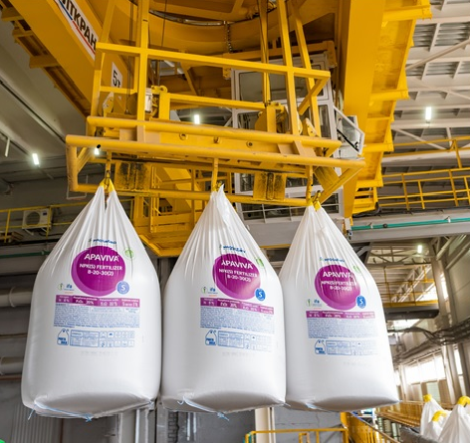
Биржевые инструменты, регионы и базисы поставки
Количество инструментов по продукции ФосАгро
в торговой системе биржи:
3 6 2
Примеры инструментов:
FAT1YUL069F:
ЖД-станция отправления, Аммофос высший сорт (МКР 1000 кг), ст. Юльевка
FAF4FOZ020A:
Поставка автотранспортом, Азотно-фосфорно-калийное удобрение NPK 10:26:26 (МКР 800/1000 кг), склад ООО ФосАгро-Ставрополь, Зеленокумск
Notes:
Africa: fastest growing continent
More than half of global population growth between now and 2050 is expected to occur in Africa. Africa has the highest rate of population growth among major areas. The population of sub-Saharan Africa is projected to double by 2050.
Economic Growth
The continent's economy grew by roughly 3.4 percent in 2017, creating one of the longest stretches of uninterrupted positive economic expansion in Africa's history. As a result, a growing number of Africans have joined the middle class each year.
According to the forecasts for the period 2018-2024, consumption of the fertilizers in Africa will increase 4,8% every year.
The key factors are: growth of the population, reduced availability of arable land.
Along with the development of the infrastructure, transfer of knowledge, support of agriculture and increased funding, we expect growth in the use of fertilizers.

Slide 6
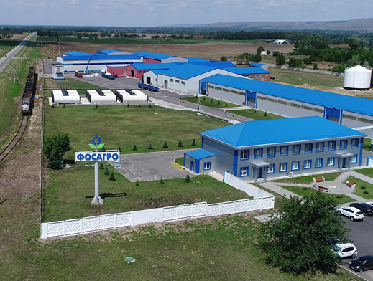
Биржевые инструменты, регионы и базисы поставки
Регионы и базисы поставки продукции ФосАгро в 2020 г.:
Саратовская обл. (FCA, ЖД-станция отправления, самовывоз а/т)
Вологодская обл. (FCA, ЖД-станция отправления, самовывоз а/т)
Краснодарский край (FCA, самовывоз а/т)
Ставропольский край (FCA, самовывоз а/т)
Ростовская обл. (FCA, самовывоз а/т)
Белгородская, Воронежская обл. (FCA, самовывоз а/т)
Курская обл. (FCA, самовывоз а/т)
Нижегородская обл., Респ. Татарстан (FCA, самовывоз а/т)
Липецкая обл. (FCA, самовывоз а/т)
Тамбовская обл. (FCA, самовывоз а/т)
Орловская, Тульская, Брянская, Калужская обл. (FCA, самовывоз а/т)
Региональные базы ФА-СевероЗапад (FCA, самовывоз а/т)

Slide 7
Итоги развития продаж на биржевых торгах в 2019 и 2020 гг.
В 2019 г.:
Начаты торги продукцией ФосАгро на бирже
Успешно организованы поставки и отработан документооборот в рамках продаж удобрений на биржевых торгах
Общий объем – 4 170 т, наибольший объем среди всех производителей
Помимо продаж с условием поставки самовывоз ЖД-транспортом с предприятий АО «Апатит», выведена на биржевые торги продукция с региональных баз ООО «ФосАгро-Регион» на условии самовывоз автотранспортом
В 2020 г.:
За 9 месяцев 2020 г. объем продаж превысил 75 000 т – больше чем объем продаж прочих производителей, вместе взятых
Организованы продажи с условием поставка автотранспортом с БФ АО «Апатит» (помимо поставки FCA-самовывоз по ЖД).
Количество базисов поставки составило 87, количество биржевых инструментов – 362
Notes:
Africa: fastest growing continent
More than half of global population growth between now and 2050 is expected to occur in Africa. Africa has the highest rate of population growth among major areas. The population of sub-Saharan Africa is projected to double by 2050.
Economic Growth
The continent's economy grew by roughly 3.4 percent in 2017, creating one of the longest stretches of uninterrupted positive economic expansion in Africa's history. As a result, a growing number of Africans have joined the middle class each year.
According to the forecasts for the period 2018-2024, consumption of the fertilizers in Africa will increase 4,8% every year.
The key factors are: growth of the population, reduced availability of arable land.
Along with the development of the infrastructure, transfer of knowledge, support of agriculture and increased funding, we expect growth in the use of fertilizers.

Slide 8
Спасибо за внимание!

